Slide 1
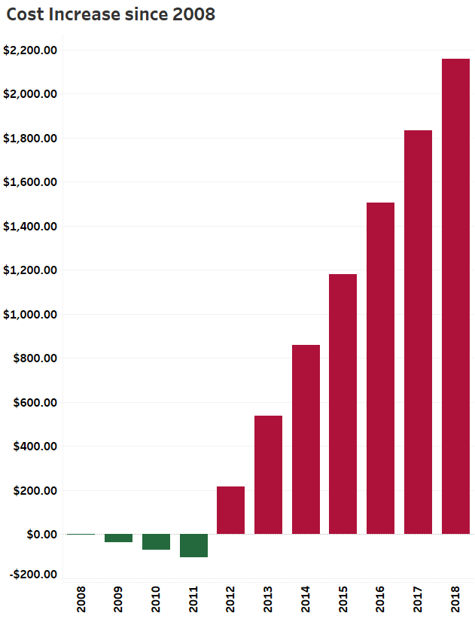
CHILD CARE COST IS ON THE RISE
$2,150.00
SINCE 2008
CONTACT YOUR REPRESENTIVE TO SUPPORT [BILLNUMBER]

